Slide 1
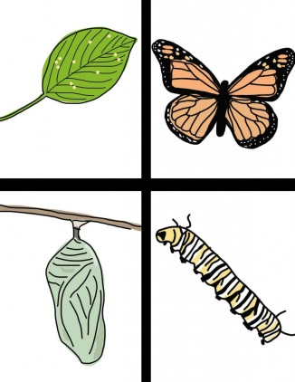
Characteristics of Living Things
Grade 7

Slide 2
Living Things
Are Composed of Cells
Have different levels of organization/structures
Use energy
Respond to their environment
Grow
Reproduce
Adapt to their environment

